Slide 2
Welcome!
We are so glad you’re here!

Slide 3
Brief Overview Session 1 & 2
Session 1 with Mishael Porembski, Founder and Author
Overview of Widow Strong
Small Group Curriculum Facilitation
Trouble Shooting
Session 2: Pastor Ron Wean, LPCC
Best Practices of Small Group Leadership
Healthy Self-Care for Leaders

Slide 4
Brief Overview Session 1 Pt 1
1 Hour Total Teaching Time
Welcome
Who We Are
Why This Matters
8 Steps of Grief Empowerment
Mini-Break: 7 minutes
How a Meeting Flows
3 Questions to Lead a Widow Strong Small Group Discussion
Teaching the Introduction & First Four Steps
Question & Answer Time: 10 minutes
Fellowship Break: 30 Minutes

Slide 5
Brief Overview Session 1 Pt 2
1 Hour Total Teaching Time
Facilitation of Sessions 5-8
Hosting The Woman of Valor Dinner Event
Questions: 10 minutes
Mini-Break 7 minutes
Importance of Widow Care & Gathering Information
Sharing Starting and Ending Surveys
Creating Events and Follow-up Team
Conflict Resolution
Question & Answer: 20 Minutes

Slide 6
Who We Are

Slide 7
Our Vision: Widow Strong is a Supportive Community Empowering Widows & Their Children To Get Stronger Together in Body, Mind, and Spirit.
Our Mission: To Serve & Connect Widows & Their Children with Experiences & Resources that Share God’s Health, Hope, Healing after Loss.

Slide 8
Our Verse: “Have I not commanded you?
Be strong & courageous.
Do not be afraid; do not be discouraged,
for the Lord your God will be with you
wherever you go.” ~ Joshua 1:9 NIV

Slide 9
How We’ve Grown
Stronger Together: 12 Stone Video

Slide 10
Why This Matters

Slide 11
The Problem:
20 Million Widows in the US, with
about 1 million New Widows per year.
Approximately 30% higher grief in children due to COVID.

Slide 12
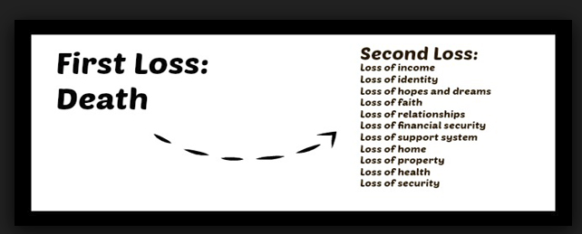
Death sets off
a domino-effect of loss…and fear.

Slide 13
Studies Show that Widows Lose:
75 % of their friendship network when they lose a spouse.
60% experience serious health issues in the first year.
33% are clinically depressed in the first month after loss.
50% remain clinically depressed a year later.

Slide 14
Trauma and Grief activates our heightened sense of Danger and Loss of Security.
This elicits a physical change in our brain and nervous system.
Basic Human Response to Trauma

Slide 16
One pastor described us by saying we move from the front row of the church to the back, and then out the door. We move from serving and singing in choir to solitude and silent sobbing, and then on to find a place where we belong.”
~Miriam Neff, Founder of Widows’ Might 2008

Slide 17
We have been Called for Such a Time as This
The Great Wealth Transfer
The largest intergenerational wealth transfer in human history is happening over the next ten years. Recipients will be Widows, Gen X, and Millennials.
This could also be the largest wave of widowhood due to the loss of Baby Boomer men.
By 2030, women will control 2/3 of the US economy.
Understanding widows is a key component to serving, empowering, and helping churches survive in difficult times.
Jesus’ ministry was supported by widows.

Slide 18
Understanding a Growing Demographic with
Tremendous Buying Power
Women typically outlast men by 15 years.
70% of women’s marriages will end in widowhood.
80% of men die married and 80% percent of women die single in the US. - WiserWomen.org
54% of women said that they did NOT want to marry again, compared with 30% of men. - 2014 Pew Research Center survey

Slide 19
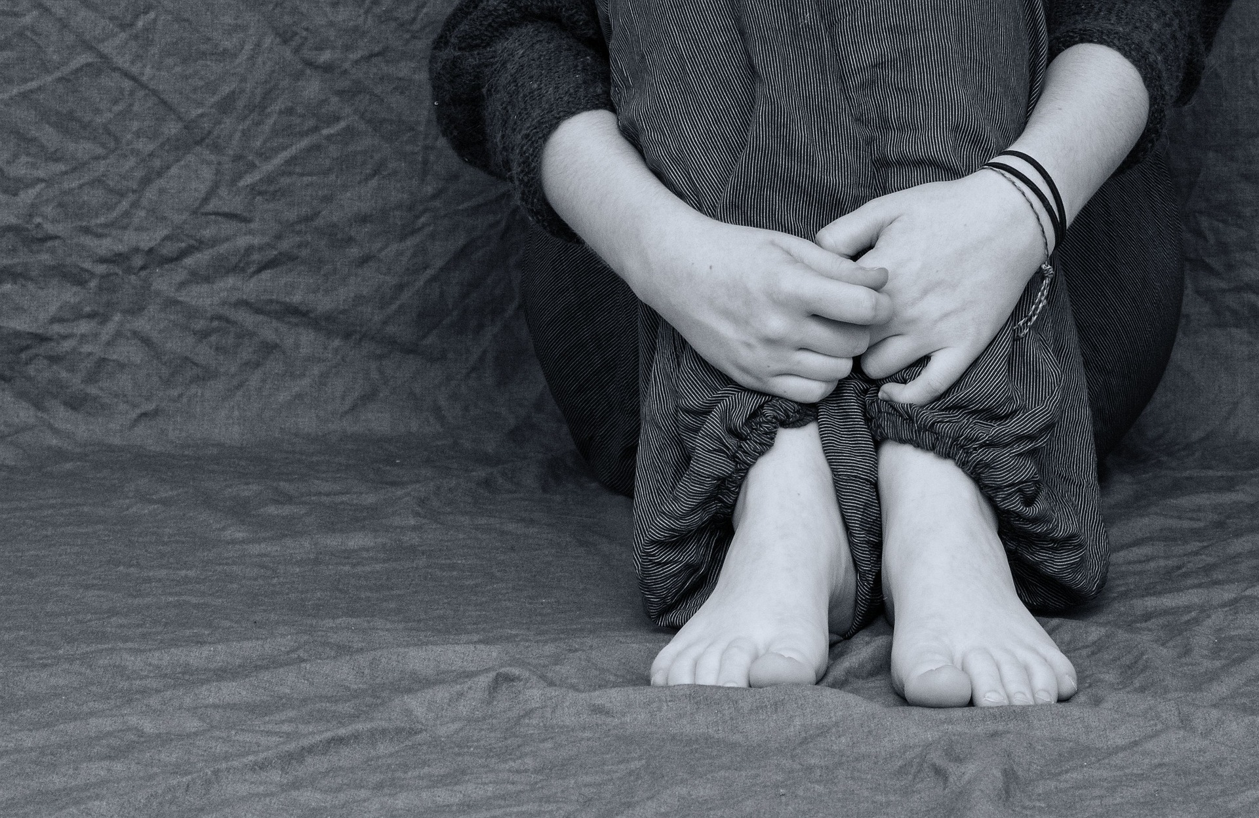
Meeting Their Needs: Widows seek engaging community & grief support.
Win-Win Solution:
We partner widow empowerment, health & wellness solutions, and churches.

Slide 20
Engaging
Solutions
That Work

Slide 21
God is doing something fresh in grief recovery.
Thank you for joining us!
“Look, I am about to do something new; even now it is coming. Do you not see it? Indeed, I will make a way in the wilderness, rivers in the desert.”
Isaiah 43:19

Slide 22
Widow Strong
A Community Approach to Grief Recovery for Widows
Hope: A holistic, step-by-step plan to
help widows empower their life after loss.
Health: Clinically-proven steps that can help women feel better faster after loss.
Healing: Connect, learn, and grow
with our in-person & online community of widows.

Slide 23
Loving Widows Well
Local Chapters: Small group grief empowerment meetings online and in partnership with churches.
Monthly Gathering Events: Monthly community outreach and workshop events for widows and their children
Service Events: Community service events for widowed families
180 Your Life Study: We created a comprehensive, clinically-proven, faith-based,12-month grief empowerment curriculum.
Leadership Training: Empowering widows to turn pain into purpose through servant leadership.

Slide 24
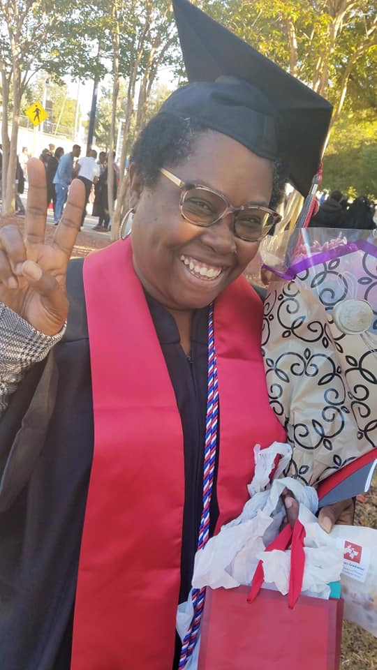
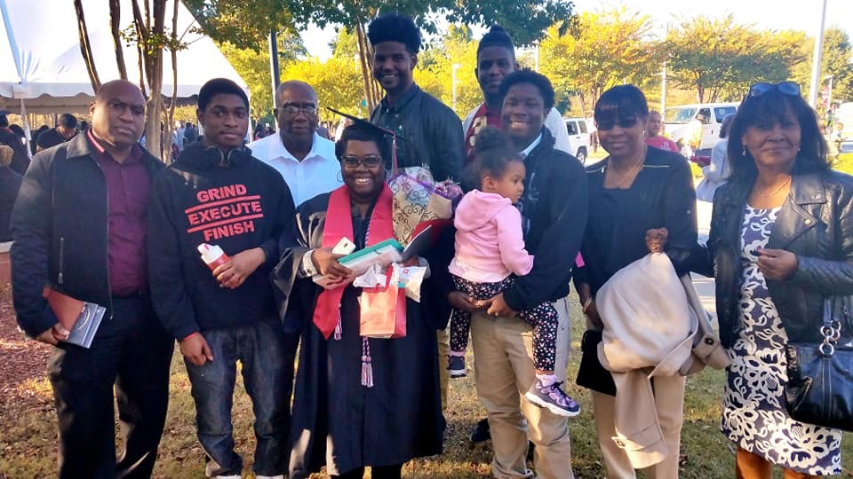
Natalie’s Story of
Long-Lasting Life Change.

Slide 25
Group Facilitator Training

Slide 26
The180 Your Life Approach:

Slide 27
180 Your Life
8 Steps of Grief Empowerment
Empower Your Ground Zero
Forge Your Team
Train Your Mind
Train Your Body
Train Your Spirit
Cross Your Finish Line
Live Your Legacy
Unveil Your Triumph

Slide 28
Let’s Take a 7 Minute Snack Break

Slide 29
Inspiring Story by Rochelle Video

Slide 30
How a Meeting Flows

Slide 31
What You Will Need
Meeting room with chairs and tissues
Possibly childcare offered depending on participants
180 Your Life 10-Week Facilitator’s box
180 Your Life Grief Guide, Facilitator’s Guide, Journal and access to videos for both Facilitators. To play the video sessions: DVD’s, DVD player, Television
Or Internet connection, computer, cable, television
Pre-order 180 Your Life Grief Guide and 180 Your Life Journal for each participant to be their for first session.
Participants can also listen to the 180 Your Life Grief Guide using audible.com.
Pad of paper to write notes.

Slide 32
3 Easy Steps for Small Group Meeting
Greet & Check-In: 60 Minutes
Video Session: 20 Minutes
Action Step: 30 Minutes

Slide 33
Our Simple Leadership Secret Sauce Questions
How are you doing today and/or this week?
How are you coming along with your action step?
(After Video Session)
What resonated with you from the video session?
What is your action step?

Slide 34
Greet & Check-In
Start on time
Open with prayer
Each small group needs 2 facilitators
Small group should have no more than 10 participants and two facilitators.
Divide the first 60 minutes by the number of participants
Give no less than 5 minutes per participant to talk.
Use your phone as a timer. Honor the timer.
Ask other members not to comment while someone else is talking.
Check in Question: How are you doing today/this week? How are you coming along with your action step?

Slide 35
Play Video Session: 20-22 minutes
Use the video session on either DVD or stream from computer.
Make sure to test video before session starts
Play video session all the way through

Slide 36
Action Step Group Discussion: 30 minutes
Ask:
What resonated with you from this video session
What is your action step for next week?
Allow each participant 3 minutes to answer.
Write down each participant’s action step.
Ask about their action step and how it went during check in at the next session.
Close out in prayer. If participants want to talk more, ask for them to wait until session is closed out.

Slide 37
Session 1: Introduction
Refer to the 10-Week Facilitator’s Guide
Open in prayer
In this session we will share our stories of loss.
Go around the room and allow each participant to introduce themselves, share their story of loss up to their comfort level, and their goal for being in group. 60 minutes total.
Watch the first video session. 20 minutes
Ask what resonated with them from the video.
Ask what action step they would like to take.
Ask them to share their contact information.
Ask them to complete the homework and chapter reading for the next session.

Slide 38
Session 2: Empower Your Ground Zero
This session helps participants establish healthy boundaries in their lives.
Follow the homework instructions in the companion journal.
Read corresponding chapters in preparation for session 3.

Slide 39
Session 3: Forge Your Team
This session helps participants establish consistent supportive community & accountability.
Follow the homework instructions in the companion journal.
Read corresponding chapters in preparation for session 4.

Slide 40
Session 4: Train Your Mind
This session helps participants clear the clutter to create peaceful space in mind, body, and spirit.
Follow the homework instructions in the companion journal.
Read corresponding chapters in preparation for session 5.

Slide 41
Session 5: Train Your Body
This session helps participants understand how foods can help or hurt our healing journey.
Follow the homework instructions in the companion journal.
Read corresponding chapters in preparation for session 6.

Slide 42
Question & Answer Session: 10 minutes

Slide 43
Fellowship Break: 30 Minutes

Slide 44
Leadership Training
Sessions 6 - 10

Slide 45
Session 6: Train Your Spirit
This session helps participants understand the science and spiritual health benefits of forgiveness, releasing anger, and embracing gratitude.
Follow the homework instructions in the companion journal.
Read corresponding chapters in preparation for session 7.

Slide 46
Session 8: Cross Your Finish Line
This session helps participants establish and achieve forward facing goals which can help the body and mind feel better faster.
Follow the homework instructions in the companion journal.
Read corresponding chapters in preparation for session 9.

Slide 47
Session 9: Live Your Legacy
This session helps participants leverage their loss into servant leadership opportunities and is an important part of the healing journey after loss.
Follow the homework instructions in the companion journal.
Read corresponding chapters in preparation for session 10.

Slide 48
Session 10: Unveil Your Triumph
This session helps participants honor their grief journey, trust Jesus, and establish new goals in community.
Offer participants Widow Strong small group continuing opportunity.
Consider using our 12-month program for a deeper dive or chose another Bible study as you do live together with your Widow Strong tribe!

Slide 49
Session 10: Unveil Your Triumph &
Woman of Valor Dinner Event
This session helps participants honor their grief journey, trust Jesus, and establish new goals in community.
Refer to the Leadership Guide for Details.
Follow the instructions in the companion journal.
Create and distribute certificates.
Invite participants to join a Widow Strong small group.
Identify and invite participants interested in co-leading the next 180 Your Life small group study.
Ask participants to fill out ending survey.
Consider using our 12-month program for a deeper dive or chose another Bible study as you do live together with your Widow Strong tribe!

Slide 50
Mini-Break 7 minutes

Slide 51
Importance of Widow Care & Gathering Information
1. One Week prior to first meeting, email group participants with links to starting survey and release forms. Forms must be filled out prior to group participation.
2. Create a phone list for participants and share at the end of the first meeting.
3. Co-leaders create a weekly follow-up email to touch base.
4. Encourage participants to sign up for the Widow Strong Newsletter.
5. Be aware of birthdays, special anniversaries, and holidays and think of sending a card.

Slide 52
Starting and Ending Surveys
1. Starting survey allows your leadership team to better understand how to help each individual.
2. Ending surveys shares information with the leadership team to better serve small group participants in the further.

Slide 53
Creating Events & a Follow Up Team
1. Discuss with your leadership team if you would like to coordinate any future outreach events and plan!
2. Creating a Social Events Team and Follow Up team from your Widow Strong small group gives participants projects to work on together.
3. Widow Strong provides a downloadable pdf of tested and successful monthly events for widows and their families.
This is a great community outreach tool!
4. Discuss with your leadership team if you would like to coordinate any future outreach events and plan!
5. Join our leadership call if you have questions.

Slide 54
Small Group Conflict Resolution Ideas
1. Discuss and develop and plan for group challenges.
2. What happens if someone refuses to stay within the discussion time allotment?
3. What happens if someone is gossiping about others in the group?
4. What happens if someone is consistently dominating group discussion?

Slide 55
Join our Small Group Leadership Calls for Additional Support
email: leadership@widowstrong.com
visit WidowStrong.com/leadership to get connected, download resources, and find relevant links.

Slide 56
Service and Educational Opportunities to Widows
Host or sponsor a local widows team using our 180 Your Life print and video curricula.
Participate in Widow Strong Online Groups & Workshops
Volunteer in service teams to help other widows.
Make a tax-deductible donation to support our programs.
Learn more at WidowStrong.com

Slide 57
Widow Strong Creates a Win-Win for
Widows and Support Partners
Support a growing community of widows
that inspires multi-generational healing after loss.
Empower widows and their children to craft a life they love with Jesus.
Inspire widows & their children toward servant leadership.

Slide 58
Question & Answer: 15 Minutes

